Slide 1



Future Retail Program(E-Commerce)
Establishing & Operating E-Store Project
Presented by: Latifa Mohmmed Alyaeesh
Link for a video: https://drive.google.com/file/d/1hizsxhvJzEw8PSwZH8COywFcS9k2iM7-/view?usp=sharing

Slide 2
Maroof
Clothing Brand

Slide 3




Business Problem

Slide 4
What are the systemic requirements that must be paid attention to before launching the electronic store?

Slide 5
The headquarters of store
Licenses
Termination of Contract
Intellectual Property
Protection of consumer personal data

Slide 6
Which delivery companies will you rely on and why?

Slide 7

Traditional Companies
Specialized Delivery Companies for e-commerce
Direct Delivery

Slide 8
Proposed payments company and why?

Slide 9

What are the payment options that will be available in my store?
What are the available payment gateways that are appropriate for my store?
Is it necessary to open a bank account in the name of my store?

Slide 10



Slide 11
Based on the brand that has been chosen , what products will you add to the store?

Slide 12
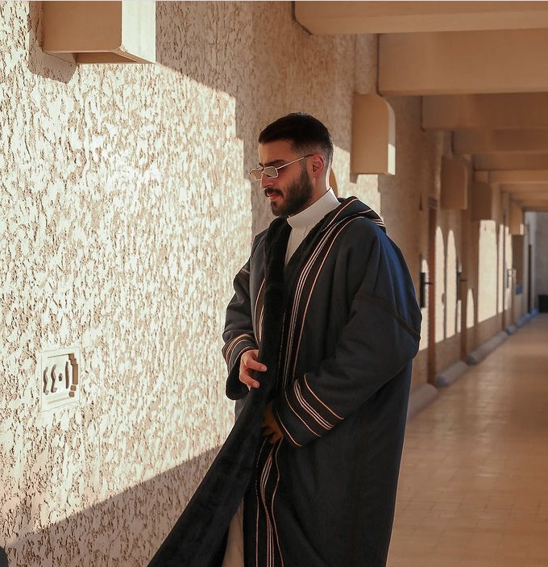


Slide 13
What are the reports that you will be keen to use during the next stages of the store journey ?

Slide 14




Sales
Orders
Visitors
Conversion Rate

Slide 15
How to take advantage of the marketing features and tools in Zid website to activate the store to increase the sales?

Slide 16






Slide 17
Who is the team the work you will need to have and what are the tasks of each team member?

Slide 18
The most important steps for choosing the staff who will work in the store:
Passion and interest in the store field
Compatibility between the work environment and the person
Experience
Love to learn

Slide 19





Production/Supply / manufacturing / import team
Marketing team
Prepare team
Customer Service team
Finance and accounting team

Slide 20
For customer service part what 10 questions expected from customers? And answer for each question

Slide 21
What are the payment methods available in your store?
Does the delivery also include those outside Saudi Arabia?
Can I exchange the product when I bought it?
When you will offer a new collection?
Do you have a discount?
How long is the delivery?
What is the minimum cost?
Can I pay cash instead of electronic card?
Is a free delivery?
Are there offers for distinguished clients?

Slide 22
What are the number and statistics that the trademark owner will be keen on sharing periodically? And why did you test each of them?

Slide 23



Sales
Number of orders
Average basket

Slide 24
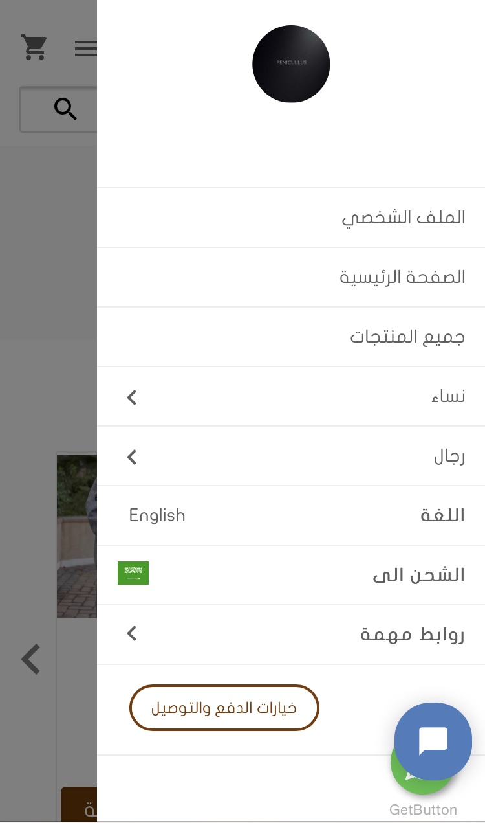
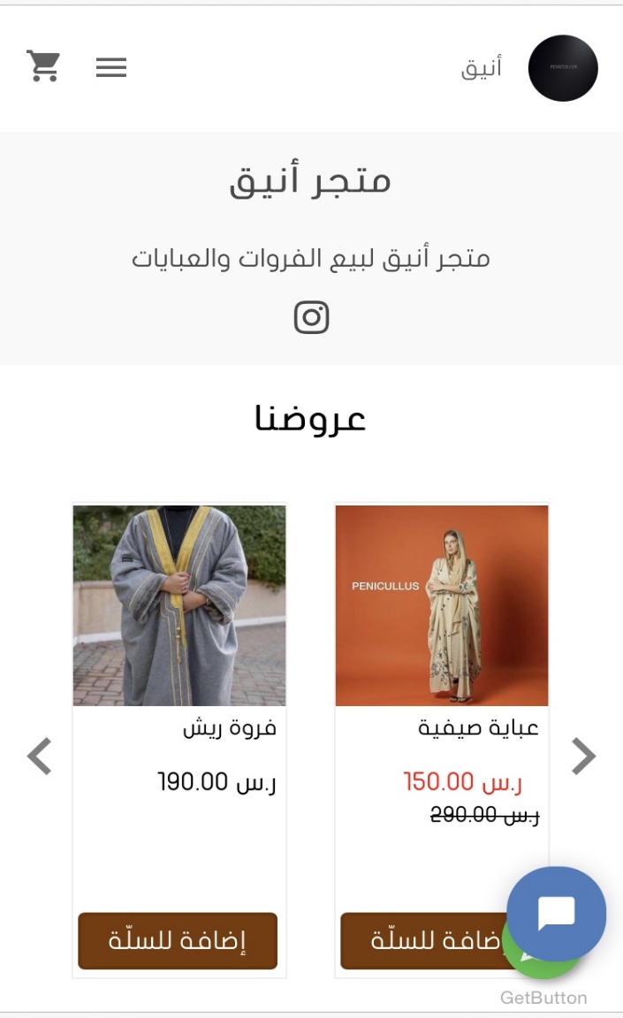
https://zid.store/fr-penicullus/
Link Penicullus Store:

Slide 25
.
THANK
YOU
For
LISTENING
ME

